Slide 1
Defense for the Adversarial Attacks on Object detection
Supervisor :Dr. Indra Deep Mastan

Slide 2
Introduction

Slide 3
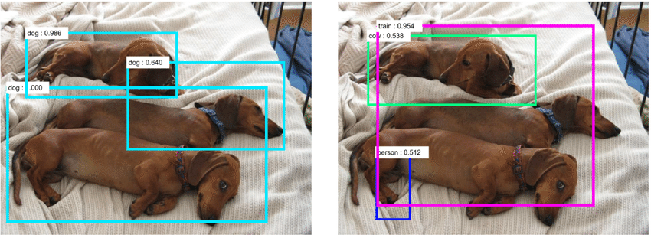
Object Detection
Computer vision technology that involves detecting and localizing objects of interest within an image or video using Deep Neural Network and Machine learning algorithm .

Slide 4
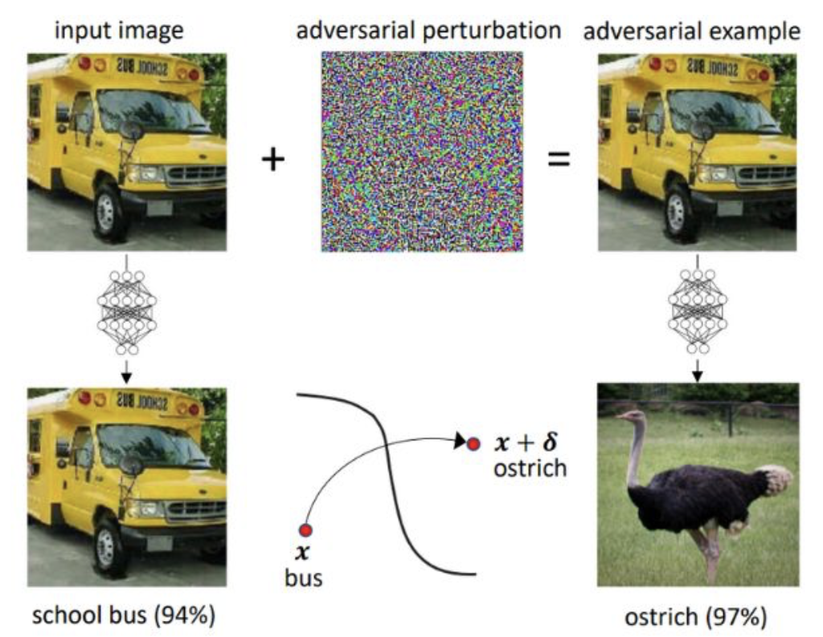
Adversarial Attacks On Object Detection
Adversarial attacks on object detection involve making subtle and undetectable alterations to the input data to cause the detection algorithm to misidentify objects.
Types of adversarial attacks:
Targeted
Untargeted

Slide 5
Dataset

Slide 6
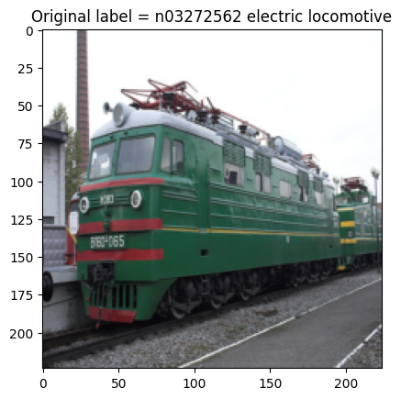
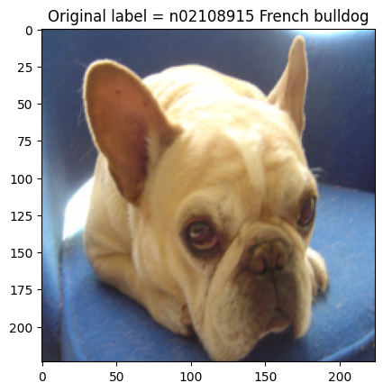
PASCAL VOC
Pascal VOC is a benchmark dataset for object recognition in computer vision.
20 common object categories (e.g., person, car) with annotated bounding boxes.

Slide 7
Fast Gradient Sign Method

Slide 8
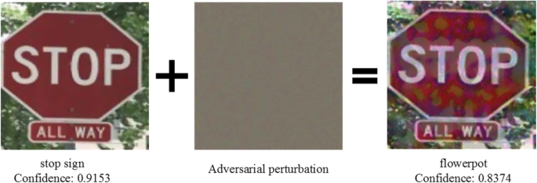
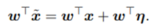
What is FGSM?
It is an adversarial attack algorithm used to generate adversarial examples for deep learning models.
In FGSM we add large amount of noise to the input image to perform the adversarial attack.
By giving the perturbation a value that most nearly resembles the weight vector w, it is possible to maximize the perturbation that results in an inaccurate prediction.

Slide 9
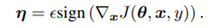
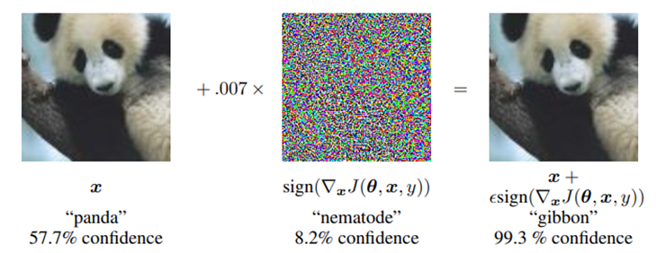
How it works?
In an adversarial attack scenario, the value of epsilon (ε) indicates the magnitude of the disturbance added to the input image. It is usually a small value.
FGSM computes the gradients of a loss function wrt to input image.
Larger confidence rate , Larger perturbation to fool My Network

Slide 10
FGSM Model: FGSM Function
Objective: To add a small perturbation to the input data to misclassify it.
Algorithm:
-FGSM computes the gradients of a loss function with respect to input image
-It uses the sign of the gradients to create a new image (the adversarial image) that maximizes the loss.
Output: We Get Perturbed/adversarial image

Slide 11
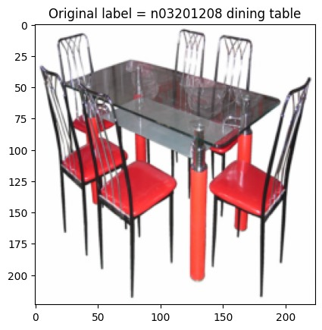
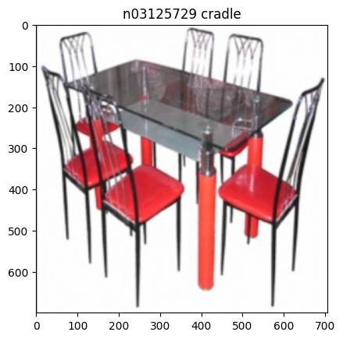
Results

Slide 12
DeepFool

Slide 13

What is DeepFool?
DeepFool is an adversarial attack method designed to deceive deep neural networks.
Fool neural networks into misclassifying input images with imperceptible perturbations.
Iterative process: Gradually modifies input to minimize classification confidence.
Minimization Objective: Perturbations aim to be small yet effective.

Slide 14
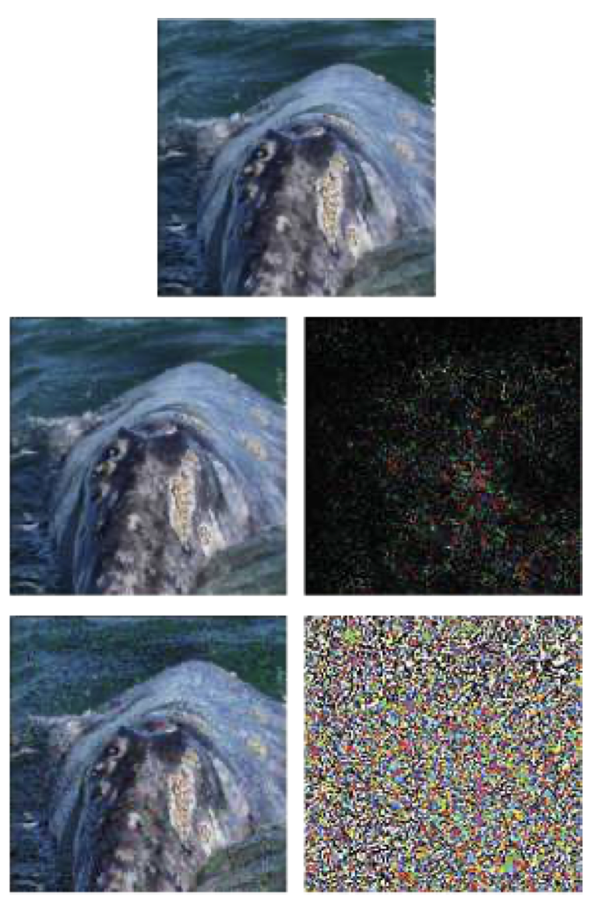
How it works?
The algorithm iteratively calculates the direction of the decision boundary and finding the smallest perturbation that crosses that boundary.
The process is repeated until the image is classified as a different class.

Slide 15
Deepfool Algorithm
Objective:
Generate minimal perturbations to fool deep neural networks.
Key Steps:
Initialize with input image, neural network (net), and parameters.
Get the output scores (f_image) and identify the target class (label).
Initialize perturbed image (pert_image) and gradient (w).
Iteratively:
Compute gradients for each class.
Choose the class that contributes most to the perturbation.
Update perturbation vector (r_i).
Update perturbed image.
Check if the perturbed image changes the classification.
Repeat until the target class changes or maximum iterations are reached.
Output:
Perturbation vector (r_tot), number of iterations (loop_i), original label (label), final label (k_i), perturbed image.

Slide 16

DeepFool model: Results

Slide 17
DIP Defend

Slide 18
DNNs can be easily fooled to make incorrect predictions through normal images with intentional, small, and human imperceptible perturbation.
This algorithm works on the basics of Deep Image Prior(DIP).
Till DIP method , all defense methods rely heavily on the external priors learned from a large training dataset, while neglecting the rich internal priors within the input itself.

Slide 19
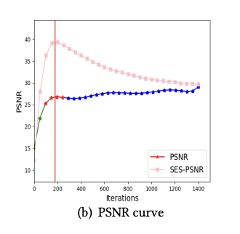
Strategy:
1) an early stage of robust feature learning for perturbation-insensitive patterns,
2) a later stage of non-robust feature learning for perturbation-sensitive patterns.
We further design an adaptive stopping strategy via second order exponential smoothing.
Image reconstruction of DIP would first undergo the recovery of low-frequency information (e.g., image contour)
Later , the recovery of high-frequency information that adversarial perturbation takes place .

Slide 20
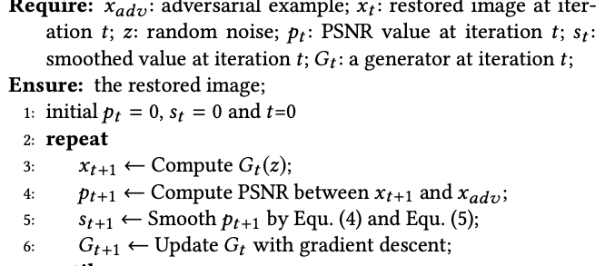
Algorithm

Slide 21
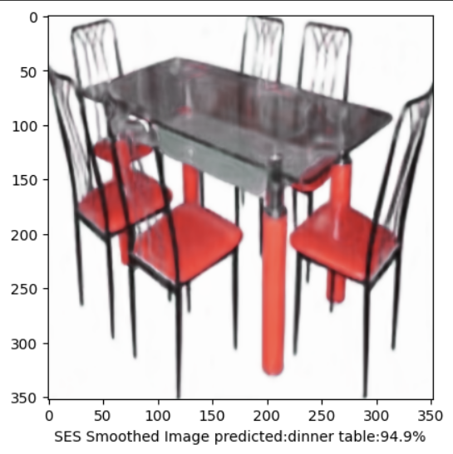
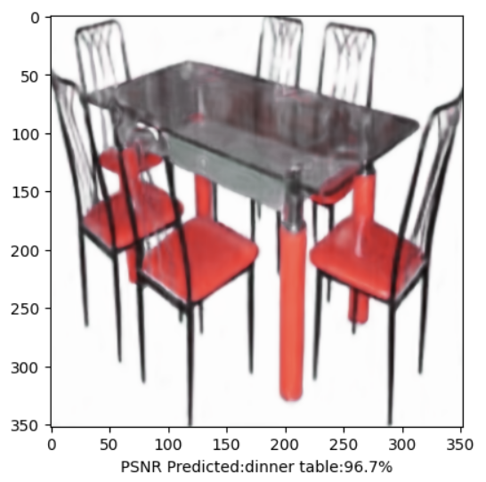
Results

Slide 22
Zero-Shot Noise2Noise

Slide 23
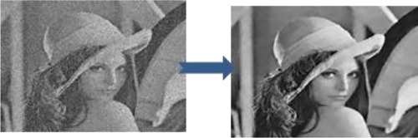
What is Zero-Shot Noise2Noise ?
No Training Data: ZS-N2N achieves denoising without any training images.
Adaptable Approach: It excels in diverse noise conditions and imaging scenarios.
Computational Efficiency: Achieves high-quality denoising with minimal computational cost.

Slide 24
How it works ?
Decomposition for Precision: ZS-N2N breaks down noisy images into correlated pairs, extracting signal similarities and independent noise, paving the way for targeted denoising.
Efficient Training Strategy: Utilizing a lightweight network and explicit regularization, ZS-N2N trains on a single noisy image, defying overfitting while ensuring robust performance.
Symmetric Consistency Enhancement: Incorporating residual learning, symmetric loss, and consistency enforcement, ZS-N2N's network optimizes noise elimination, achieving impressive denoising with minimal computational cost.

Slide 25
ZS-N2N Algorithm
Objective:
Achieve robust image denoising using a lightweight neural network without extensive training data.
Key Steps:
Train a simple 2-layer neural network on downsampled pairs of noisy images.
Implement residual learning for noise fitting and a symmetric loss for stability.
Apply the trained network to denoise input images effectively.
Output:
Efficient denoising with promising results, demonstrated through denoised images and peak signal-to-noise ratio (PSNR) evaluation.

Slide 26
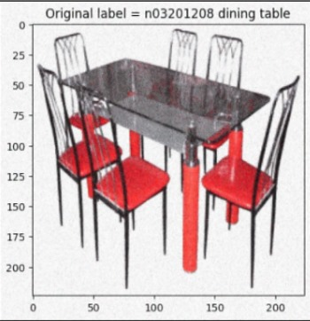
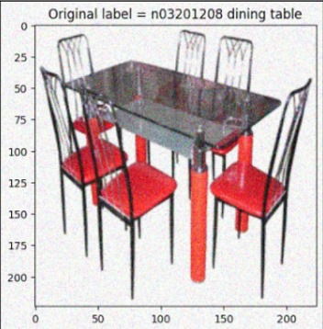
Result

Slide 27
Conclusion

Slide 28
FGSM vs DeepFool
FGSM
DeepFool
Simple to implement and fast to produce
Effective in producing small perturbations that can cause misclassification
Can produce high-frequency noise that can be detected by human eyes
Time-consuming and resource-intensive.
Effective in generating hard-to-detect adversarial examples that can be used to evaluate the robustness of a model.
Produces a misclassified image with low frequency noise

Slide 29
DIP Defend vs Zero-Shot Noise2Noise
DIP Defend
Zero-Shot Noise2Noise
Training Efficiency:Fast Convergence, Lightweight Network.
Approach to Adversarial Defense:Leverages generative network reparameterization to minimize adversarial impact by tapping into internal image priors.
Learning Preferences:Adaptive stopping with exponential smoothing for controlled training.
Efficient CPU Denoising, 1-2k Iterations.
Trains on one noisy image, using a shallow network and explicit regularization to prevent overfitting.
Lightweight network, residual learning, symmetric loss, and consistency enforcement for enhanced denoising.

Slide 30
Bibliography
I. J. Goodfellow, J. Shlens, and C. Szegedy, “Explaining and harnessing adversarial examples,” arXiv preprint arXiv:1412.6572, 2014.
S.-M. Moosavi-Dezfooli, A. Fawzi, and P. Frossard, “Deepfool: a simple and accurate method to fool deep neural networks,” in Proceedings of the IEEE conference on computer vision and pattern recognition, pp. 2574–2582, 2016.
D. W. B. C. J. L. Y. J. S.-T. X. Tao Dai, Yan Feng, “Dipdefend: Deep image prior driven defense against adversarial examples,” in Proceedings of the 28th ACM International Conference on Multimedia, 2020.
D. Ulyanov, A. Vedaldi, and V. Lempitsky, “Deep image prior,” in Proceedings of the IEEE conference on computer vision and pattern recognition, pp. 9446–9454, 2018.
Y. Mansour and R. Heckel, “Zero-shot noise2noise: Efficient image denoising without any data,” in Proceedings of the IEEE/CVF Conference on Computer Vision and Pattern Recognition, pp. 14018–14027, 2023.
A. Kurakin, I. J. Goodfellow, and S. Bengio, “Adversarial examples in the physical world,” in Artificial intelligence safety and security, pp. 99–112, Chapman and Hall/CRC, 2018.
D. Wang, W. Yao, T. Jiang, G. Tang, and X. Chen, “A survey on physical adversarial attack in computer vision,” arXiv preprint arXiv:2209.14262, 2022.
M. Everingham, L. Van Gool, C. K. I. Williams, J. Winn, and A. Zisserman, “The PASCAL Visual Object Classes Challenge 2007 (VOC2007) Results.” http://www.pascalnetwork.org/challenges/VOC/voc2007/workshop/index.html.
A. Chakraborty, M. Alam, V. Dey, A. Chattopadhyay, and D. Mukhopadhyay, “A survey on adversarial attacks and defences,” CAAI Transactions on Intelligence Technology, vol. 6, no. 1, pp. 25–45, 2021.
A. Sharma, Y. Bian, P. Munz, and A. Narayan, “Adversarial patch attacks and defences in visionbased tasks: A survey,” arXiv preprint arXiv:2206.08304, 2022.

Slide 31
Thank You
Suryansh Bhardwaj(20UCC108)
Madhav Maheshwari(20UCC061)
Sankalp Jain(20UCS172)
Arunabh Agarwal(20UEC032)

